Slide 1
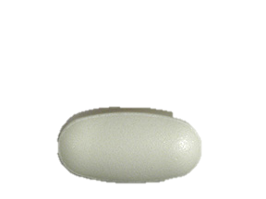
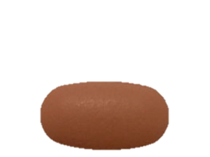
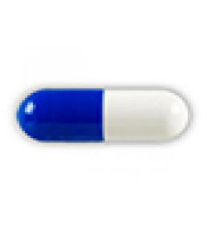
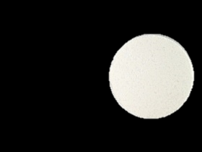
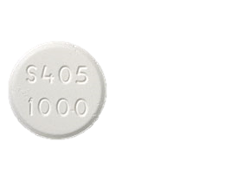
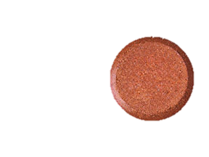
Binder yog dab tsi thiab Vim yog li cas kuv thiaj yuav tsum muaj?
Txhawm rau qee tus neeg lim raum, Kev tswj cov kuas phosphorus los ntawm kev noj zaub mov xwb tsis txaus. Yog li ntawv cov tshuaj hu ua phosphorus binders thiaj raug sau tseg.
Binder yog dab tsi?
Phosphorus binders yog cov ntsiav tshuaj uas kws kho mob tau sau tseg los tswj cov phosphorus hauv cov ntshav.
Kev ua huaj lwm ntawm binder:
Qee cov binders ua hauj lwm zoo li cov hlau nplaum thiab qee cov ua hauj lwm zoo li daim txhuam cev. Lawv nqus los yog khi rau phosphorus hauv cov zaub mov thaum noj mov mus hauv plab. Qhov no txo ​​cov phosphorus uas nkag mus rau hauv cov hlab ntsha. Yog tsis tau lub binder Phosphorus, tuaj yeem yuav raug khaws cia hauv cov ntshav.
Binders tseem ceeb heev vim tias kev lim ntshav tsis tshem tawm phosphorus los ntawm cov ntshav.
Hom binders muaj xws li:
Koj tus kws kho mob yuav txiav txim siab seb cov tshuaj twg yog hom zoo tshaj rau koj.
Auryxia® Calcium Calcium Lanthanum Sevelamer Velphoro®
Acetate Carbonate Carbonate
Thaum twg kuv tau txais binders?
Feem ntau lawm lawv raug qhia kom noj thaum pib ntawm txhua pluas uas noj mov. Tej zaum yuav raug pom zoo noj uas cov khoom noj txom ncauj los yog khoom noj ua si.
Yuav ua li cas yog tias kuv tsi nco qab?
Lub sij hawm ua ntej noj mov yog qhov tseem ceeb. Binders yuav ua hauj lwm zoo tshaj plaws thaum noj nrog zaub mov yog cias lub sij hawm dhua mus ntev binder yuav ua hauj lwm tsis tshua muaj zog.
Cov ntaub ntawv no tsuas yog siv rau cov ntaub ntawv xov xwm xwb thiab tsis yog qhov hloov pauv rau cov lus qhia los sis kev kho mob. Sib tham txog koj qhov kev kuaj mob tshwj xeeb, kev kho mob, kev noj haus thiab cov lus nug txog kev noj qab haus huv. Yog tias koj tab tom ntsib teeb meem kev kho mob, hu rau 9-1-1. Cov npe khoom lag luam yuav raug suav nrog hauv daim ntawv tshaj tawm no rau kev kawm nkaus xwb. DaVita tsis pom zoo tias ib hom twg thiaj zoo duas ib hom. Muaj lwm hom dhau ntawm no uas siv tau ib yam.
©2015- 2019 DaVita Inc. Muaj tswv thiab tsis pub leej twg paub tsuas yog siv rau kev sab xwb.

Slide 2
Cov ntaub ntawv pov thawj:
Davita.com/diet-nutrition/articles/basics/phosphorus-binders-or phosphate-binders-and-the-dialysis-diet
Cov ntaub ntawv no tsuas yog siv rau cov ntaub ntawv xov xwm xwb thiab tsis yog qhov hloov pauv rau cov lus qhia los sis kev kho mob. Sib tham txog koj qhov kev kuaj mob tshwj xeeb, kev kho mob, kev noj haus thiab cov lus nug txog kev noj qab haus huv. Yog tias koj tab tom ntsib teeb meem kev kho mob, hu rau 9-1-1. Cov npe khoom lag luam yuav raug suav nrog hauv daim ntawv tshaj tawm no rau kev kawm nkaus xwb. DaVita tsis pom zoo tias ib hom twg thiaj zoo duas ib hom. Muaj lwm hom dhau ntawm no uas siv tau ib yam.
©2015- 2019 DaVita Inc. Muaj tswv thiab tsis pub leej twg paub tsuas yog siv rau kev sab xwb.

